Slide 1
Programming Machine Learning Applications
Lecture One: A Review of Machine Learning Concepts
Dr. Aleksandar Velkoski

Slide 2
About Me
Work for REALTORS®
Teach at DePaul
Advise Startups
Volunteer at Chicago ML

Slide 3
About You
Name
Degree Program
Work Experience
Interests

Slide 4
Course Overview

Slide 5
Purpose of Class
To strengthen hands-on experience developing machine learning algorithms in the context of popular applications.

Slide 6
Assignments
Assignment 0 - Introductions
Assignment 1 - Basic Data Processing & Analysis
Assignment 2 - k-Nearest-Neighbor Classification
Assignment 3 - Linear Regression & Clustering
Assignment 4 - PCA, ARM, & Item-Based Recommendation

Slide 7
Final Project
Data Analysis
Application Development

Slide 8
Tentative Schedule
Show schedule.

Slide 9
Office Hours
Tuesday 4:00pm to 5:30pm
CDM Center Building, Room 522
312-362-1279
avelkosk@cdm.depaul.edu

Slide 10
Machine Learning

Slide 11
Machine Learning?
Computer programs that learn to improve performance at a task based on experience. (Mitchell, 1997).

Slide 12
Supervised Learning
Learning from training data with class labels

Slide 13
Unsupervised Learning
Learning from training data without class labels

Slide 14
Semi-Supervised Learning
Learning from training data with and without class labels

Slide 15
Reinforcement Learning
Learning from actions that maximize cumulative reward

Slide 16
Fundamental Concepts

Slide 17
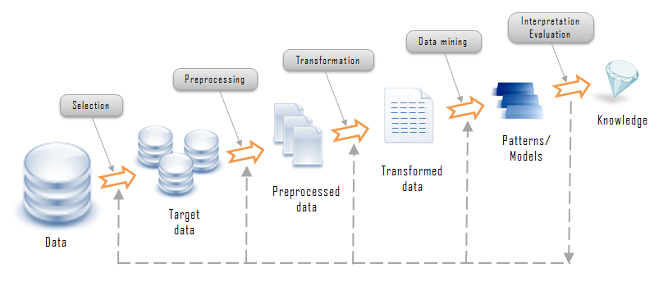
Knowledge Discovery Framework
Source: http://www.rithme.eu/?m=home&p=kdprocess&lang=en

Slide 18
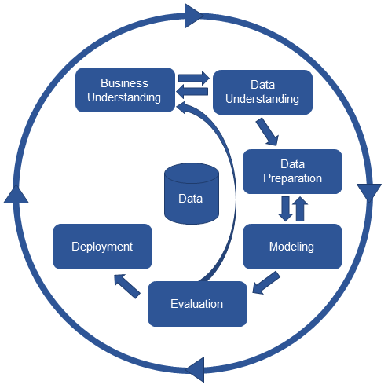
CRISP-DM Framework
Source: http://www.kdnuggets.com/2017/01/four-problems-crisp-dm-fix.html

Slide 19
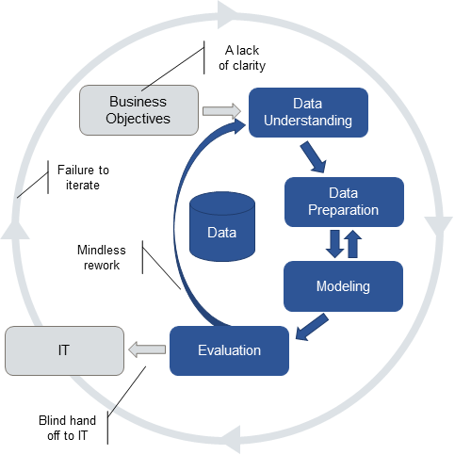
Issues with CRISP-DM in Practice
Source: http://www.kdnuggets.com/2017/01/four-problems-crisp-dm-fix.html

Slide 20
From Domain Concepts to Features
Prediction Problem
Domain Concept
Domain Concept
Target Concept
Feature
Feature
Feature
Feature
Feature
Target Feature

Slide 21
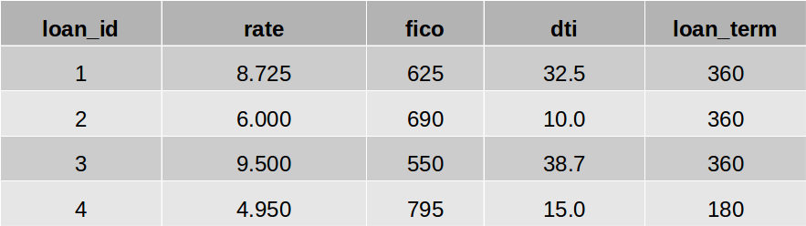
Instances and Features
Database rows → instances
Database columns → features

Slide 22
Basic Learning Model
Data
Algorithm
x₁ | x₂ | x₃ | x₄ | y
- | - | - | - | -
- | - | - | - | -
y = f(x₁,x₂,x_{3,}x₄)

Slide 23
Example of Basic Learning Model
Data
Algorithm
x₁ | x₂ | x₃ | x₄ | y
Mike | P | 7 | Y | Y
Nancy | AP | 3 | N | N
IF x₂ = “P”
OR x₃ > 6
OR x₄ = “Y”
THEN y = “Y”

Slide 24
Ill-posed Problem
Unique solution cannot be determined using only the available training data.
x₁ | x₂ | x₃ | x₄ | y
0 | 0 | 1 | 0 | 0
0 | 1 | 0 | 0 | 0
0 | 0 | 1 | 1 | 1
1 | 0 | 0 | 1 | 1
0 | 1 | 1 | 0 | 0
1 | 1 | 0 | 0 | 0
Source: https://web.engr.oregonstate.edu/~tgd/classes/534/slides/part1.pdf

Slide 25
Inductive Bias
A set of assumptions that defines model selection criteria.
Restriction
Preference

Slide 26
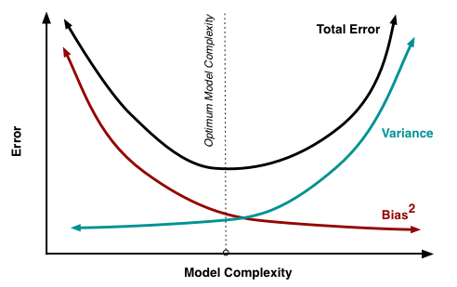
Model Complexity
Source: http://www.cs.cornell.edu/courses/cs4780/2015fa/web/lecturenotes/lecturenote12.html

Slide 27
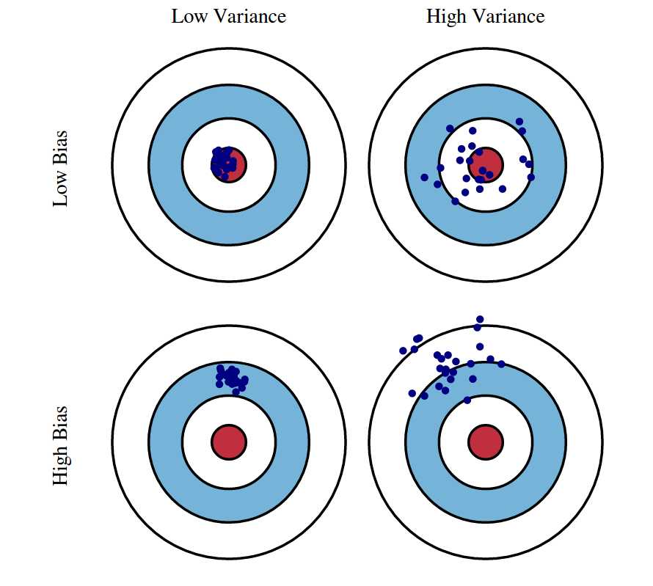
Bias-Variance Tradeoff
Source: http://www.cs.cornell.edu/courses/cs4780/2015fa/web/lecturenotes/lecturenote12.html

Slide 28
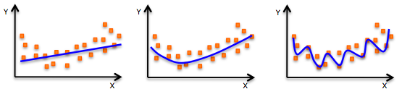
Underfitting and Overfitting
Source: https://web.stanford.edu/class/cs46n/day_two_readings.htm

Slide 29
Getting to Know your Data

Slide 30
Too Many Algorithms!
Knowing the problem, and your data, can help you with choosing the right approach.

Slide 31
Invalid Data?
Real world data is often incomplete, inconsistent, and noisy.

Slide 32
Trust?
If you can’t trust the data, can you trust the decision?

Slide 33
Analytic Base Table

Slide 34
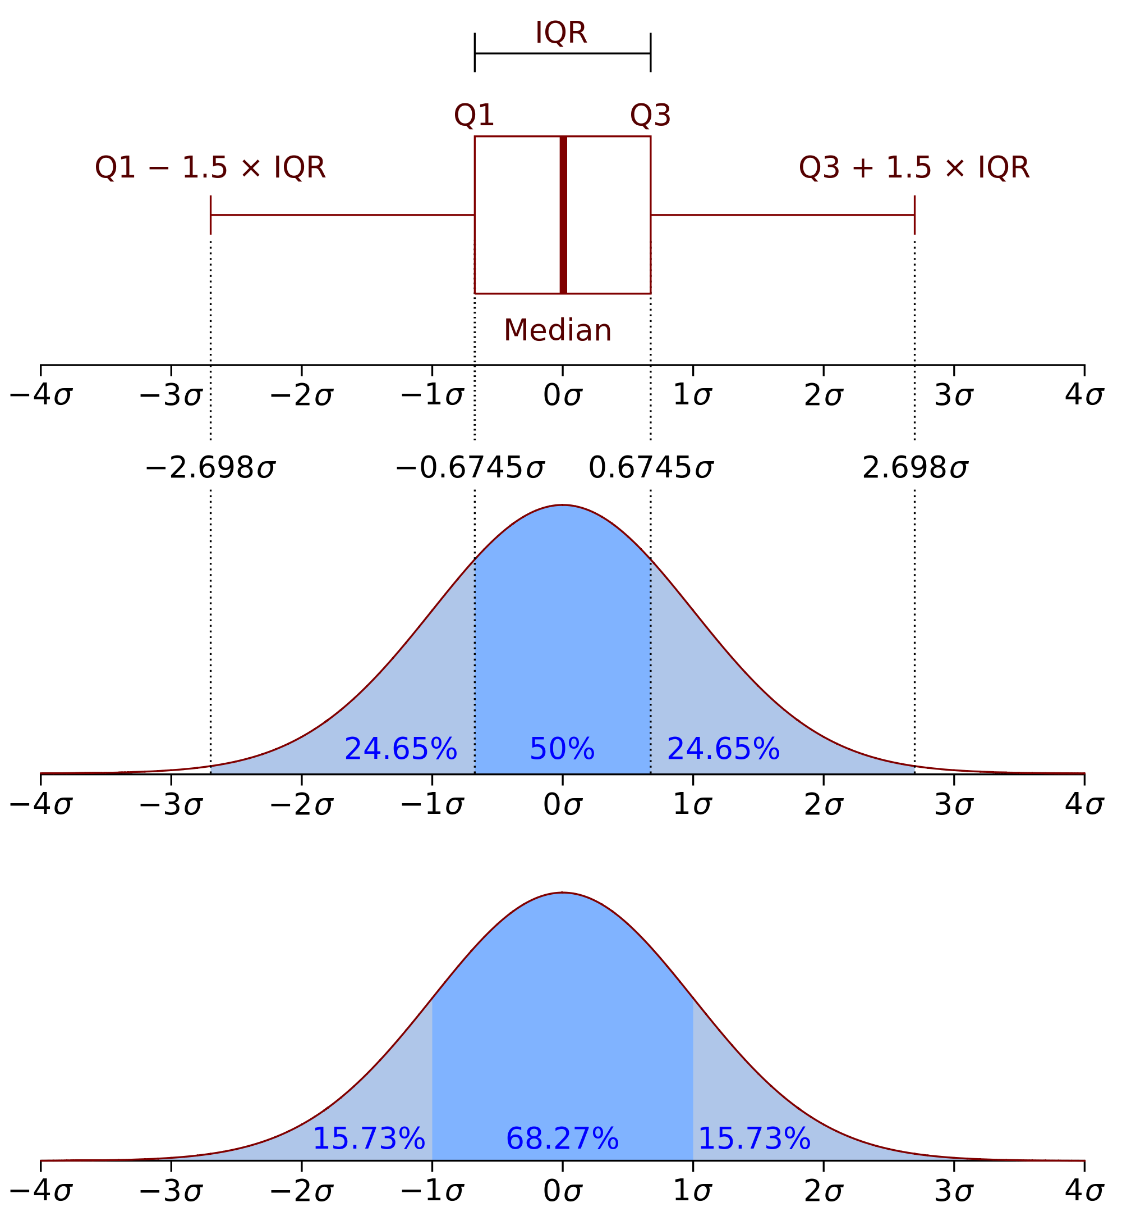
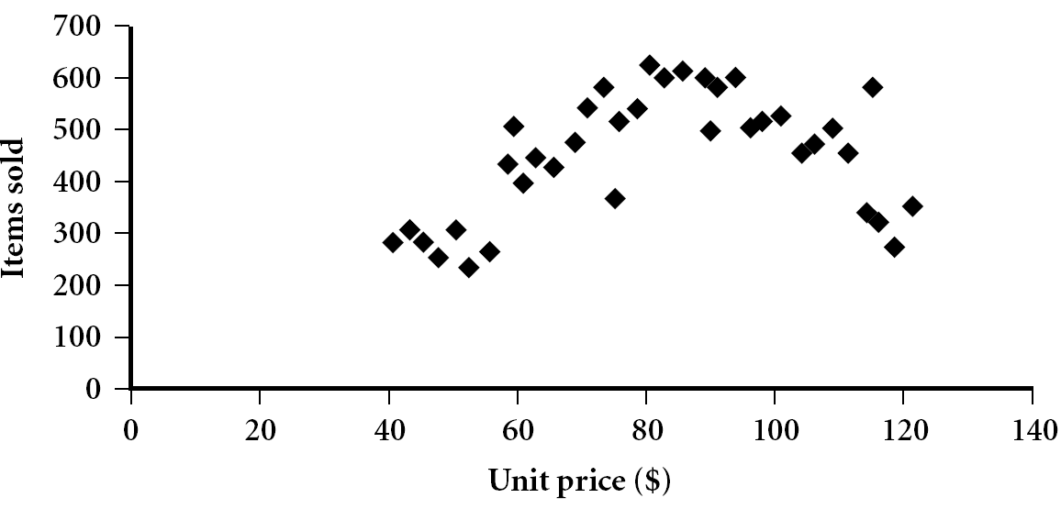
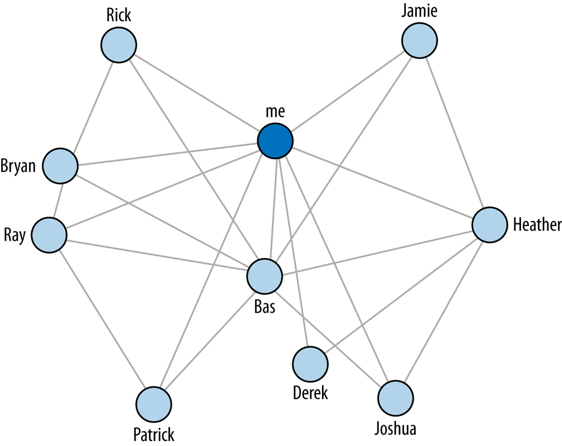
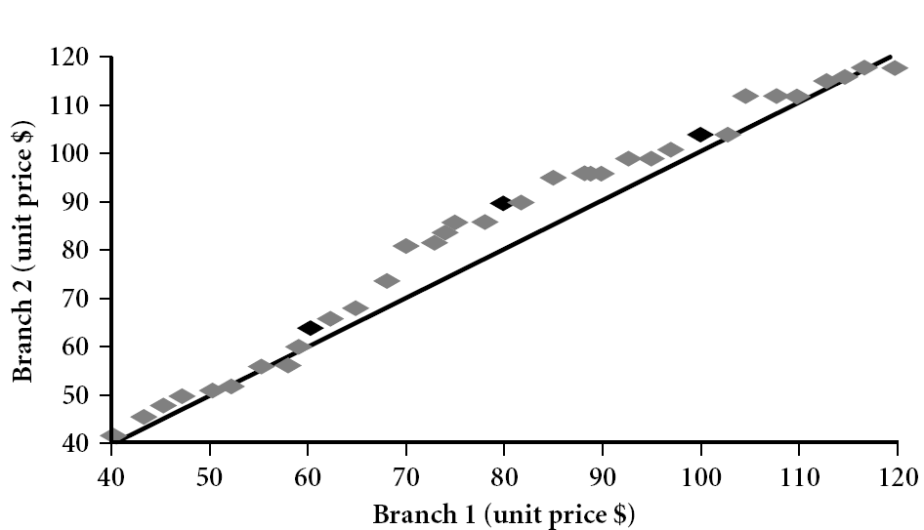
Visualizing Data

Slide 35

Covariance
Suppose stocks A and B have these values: (2, 5), (3, 8), (5, 10), (4, 11), (6, 14).
E(A) = (2 + 3 + 5 + 4 + 6)/ 5 = 20/5 = 4
E(B) = (5 + 8 + 10 + 11 + 14) /5 = 48/5 = 9.6
Cov(A,B) = (2×5+3×8+5×10+4×11+6×14)/5 − 4 × 9.6 = 4

Slide 36
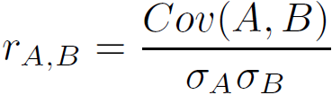
Correlation

Slide 37
Data Quality Reports
Feature | Missing | Mean | ... | Max
- | - | - | - | -
- | - | - | - | -
Feature | Missing | Mode | ... | Mode Freq.
- | - | - | - | -
- | - | - | - | -

Slide 38
Data Quality Plan
Feature | Issue | Strategy
- | - | -
- | - | -

Slide 39
Dealing with Quality Issues

Slide 40
Addressing Missing Cases
Ignore
Fill in manually
Global constant
Feature mean
Feature mean by class
Infer

Slide 41
Irregular Cardinality
Ignore
Fill in manually
Global constant
Feature mode
Feature mode by class
Infer

Slide 42
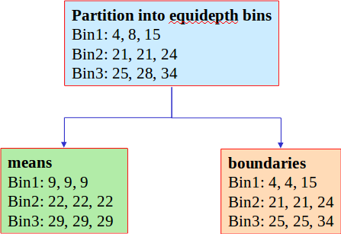
Smoothing Noise via Binning
Original Data: 4, 8, 15, 21, 21, 24, 25, 28, 34

Slide 43
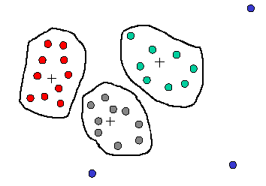
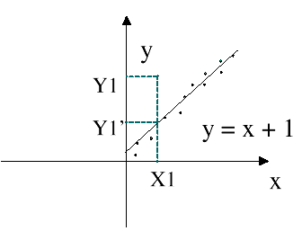
Smoothing Noise via Other Methods
Clustering
Regression

Slide 44
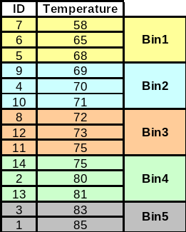
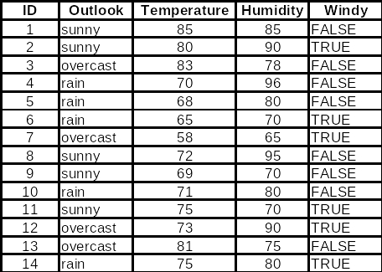
Let’s Smooth Temperature

Slide 45
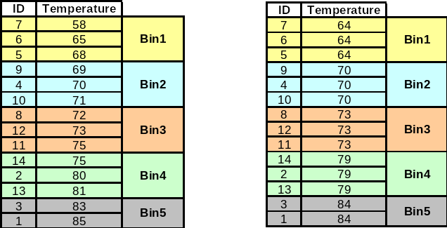
Let’s Smooth Temperature

Slide 46
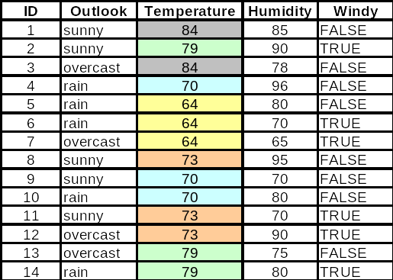
Let’s Smooth Temperature

Slide 47
Handling Outliers
Clamp all values above an upper threshold, and below a lower threshold, to threshold values. Else, return the relevant value.
lower if a_{i} < lower
upper if a_{i} > upper
a_{i} otherwise
a_{i} =

Slide 48
Handling Outliers
Are there any other techniques?

Slide 49
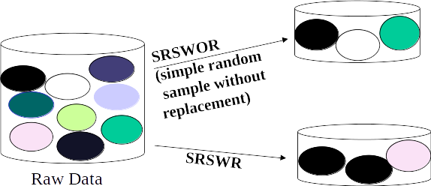
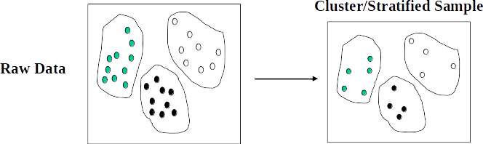
Sampling Techniques

Slide 50
Data Preparation

Slide 51
About Normalization
Adjusting values measured on different scales to a common scale.

Slide 52
Normalization Techniques
Min-max normalization: linear transformation from v to v’
v’ = [(v - min)/(max - min)] x (newmax - newmin) + newmin
z-score normalization: based on mean and standard deviation
v’ = (v - Mean) / StandardDeviation
Decimal scaling: moves the decimal by j positions such that j is the minimum number of positions moved so that absolute maximum value falls in [0..1]
v’ = v / 10j

Slide 53
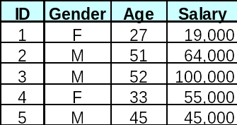
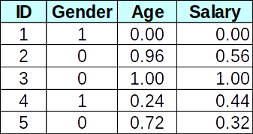
Min-Max Example
v’ = [(v - min)/(max - min)] x (newmax - newmin) + newmin

Slide 54


Z-Score Example
Mean: 80.3
Std: 9.84
v’ = (v - Mean) / StandardDeviation

Slide 55
Decimal Scaling
v’ = v / 10j
If v in [-56 .. 9976] and j=4 v’ in [-0.0056 .. 0.9976]

Slide 56
About Discretization
3 Types of attributes
Nominal - values from an unordered set (also “categorical” attributes)
Ordinal - values from an ordered set
Numeric /continuous - real numbers (but sometimes also integer values)
Reduce the number of values for a given continuous features and generate concept hierarchies
For example, collecting and replacing low level concepts (e.g., numeric values for “age”) by higher level concepts (e.g., “young”, “middle aged”, “old”)

Slide 57
Discretization Techniques
Binning - Top-down split, unsupervised
Histogram analysis - Top-down split, unsupervised
Clustering analysis - Unsupervised, top-down split or bottom-up merge
Decision-tree analysis - Supervised, top-down split
Correlation analysis - Unsupervised, bottom-up merge

Slide 58
Discretization via Binning
Equal-width (distance) partitioning
Divides the range into N intervals of equal size: uniform grid
If A and B are the lowest and highest values, the width of intervals will be: W = (B –A)/N.
The most straightforward, but outliers may dominate presentation
Skewed data is not handled well
Equal-depth (frequency) partitioning
Divides the range into N intervals, each containing approximately same number of samples
Good data scaling
Managing categorical attributes can be tricky

Slide 59
Discretization via Classification and Correlation
Classification (e.g., decision tree analysis)
Supervised: Given class labels, e.g., cancerous vs. benign
Using entropy to determine split point (discretization point)
Top-down, recursive split
Correlation analysis (e.g., Chi-merge: χ2-based discretization)
Supervised: use class information
Bottom-up merge: merge the best neighboring intervals (those with similar distributions)
Merge performed recursively, until a predefined stopping condition

Slide 60

Discretization Example
Low = 60-69
Normal = 70-79
High = 80+

Slide 61
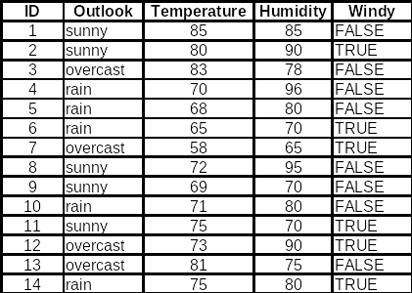
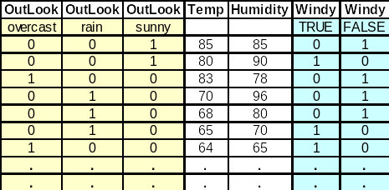
From Categories to Numbers

Slide 62
Data Reduction
Data is often too large; reducing data can improve performance
Data reduction consists of reducing the representation of the data set while producing the same (or almost the same) results
Data reduction includes:
Data cube aggregation
Dimensionality reduction
Discretization
Numerosity reduction

Slide 63
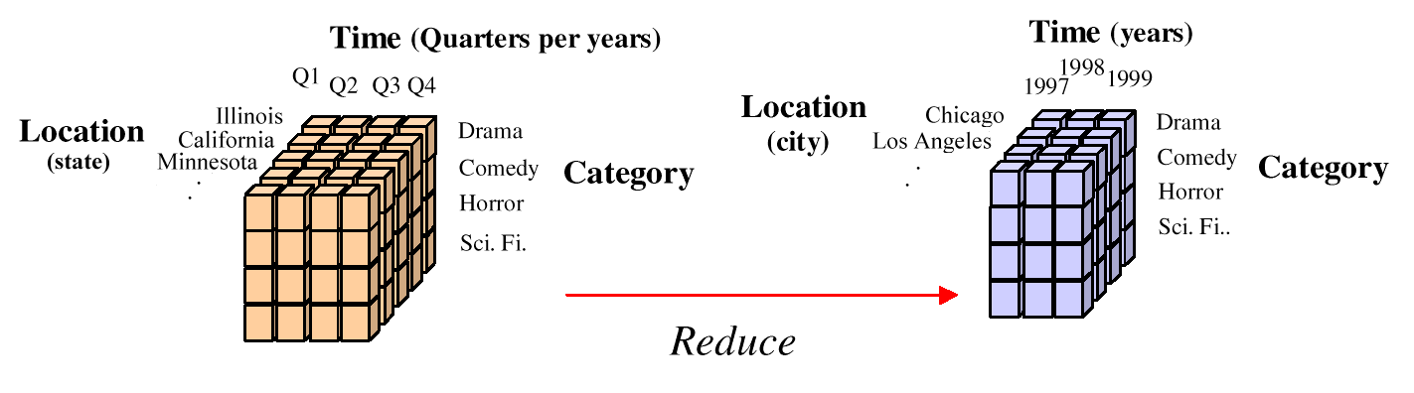
Cube Aggregations

Slide 64
Dimensionality Reduction
Curse of dimensionality
When dimensionality increases, data becomes increasingly sparse
Density and distance between points, which is critical to clustering, outlier analysis, becomes less meaningful
The possible combinations of subspaces will grow exponentially
Dimensionality reduction
Avoid the curse of dimensionality
Help eliminate irrelevant features and reduce noise
Reduce time and space required in data mining
Allow easier visualization
Dimensionality reduction techniques
Principal Component Analysis
Feature selection (tree induction, heuristic search)
Feature engineering

Slide 65
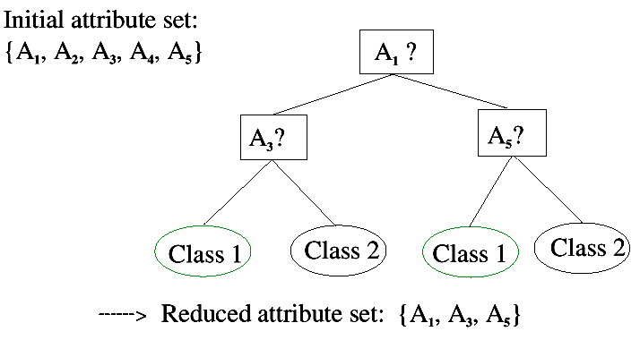
Tree Induction Example

Slide 66
Questions
Wrapping-up the Lecture

Slide 67
What is domain knowledge and why is it important?

Slide 68
What is meant by inductive bias?

Slide 69
Explain ill-posed problems.

Slide 70
What is the difference between normalization and discretization?

